Slide 1
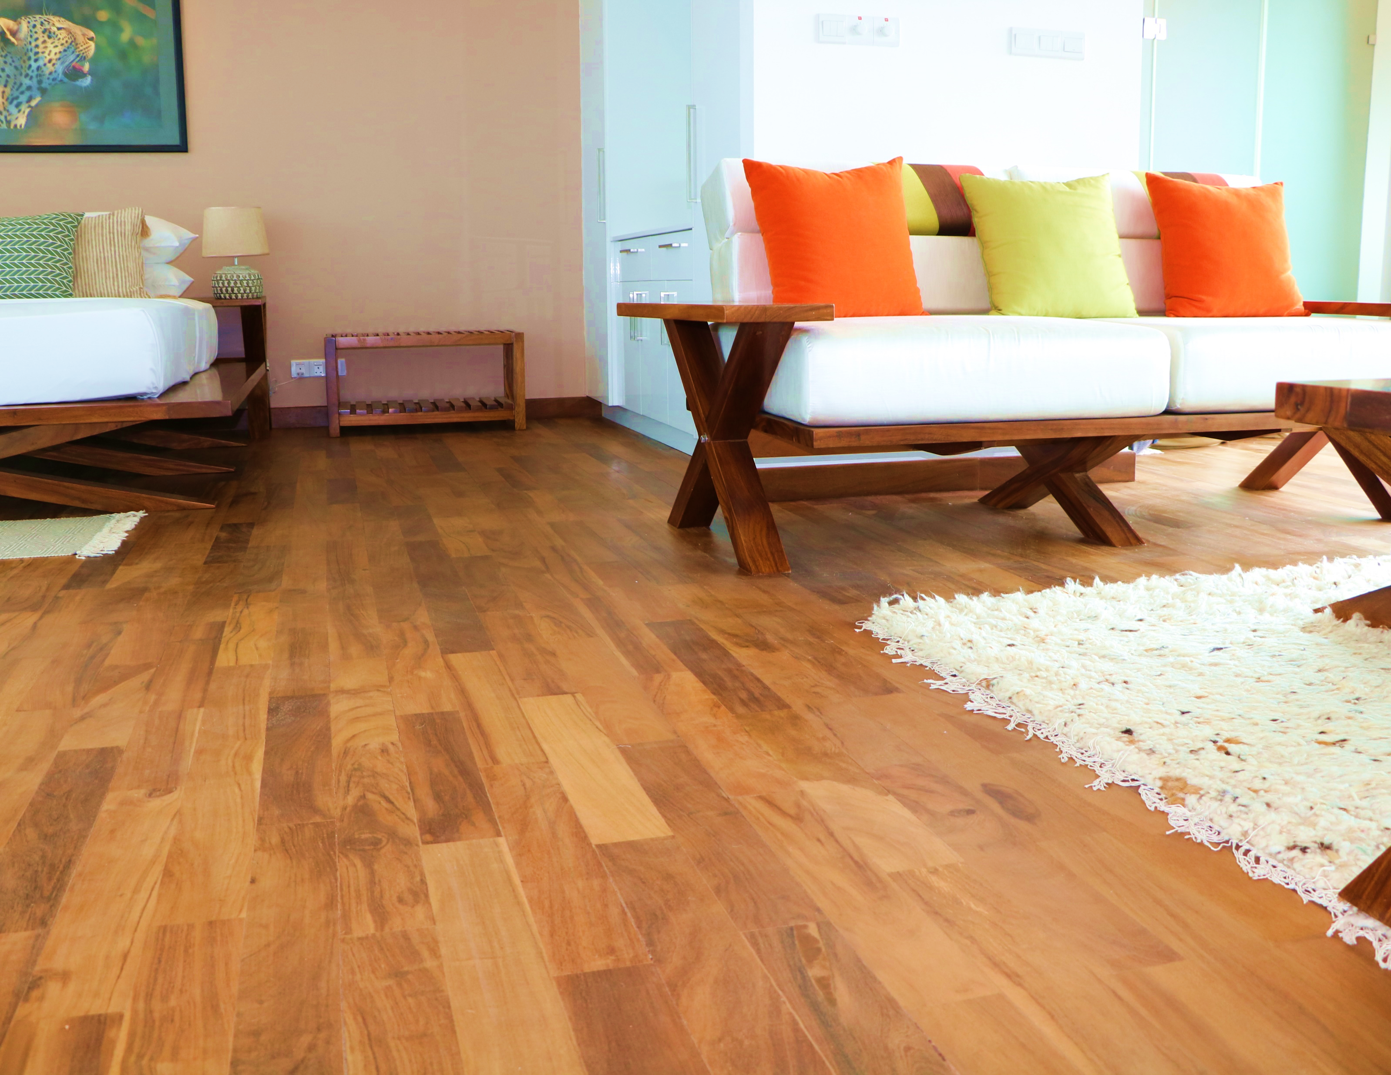
FLOORING INDUSTRY BASED ON LOCALLY AVAILABLE TIMBER

Slide 2
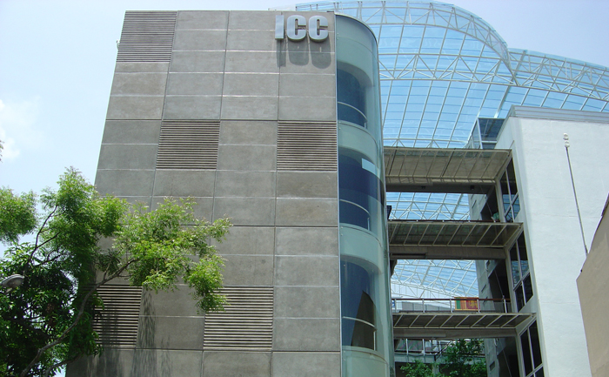
We, ICC……
A Leading Solution Provider in the Construction Industry Since 1980
One of the Largest and Well-Reputed Civil Engineering Organizations in Sri Lanka
ISO Certified, CS2 Rated Contractor and a Developer
Empowered with Modern Technology and a Well-Experienced Team
Diversified into Various Segments such as Precast Concrete Solutions, Ready-mix Concrete and Wall Paneling Systems such as Acotech and Durra.

Slide 3
ICC PRODUCTS AND SERVICES
1.

Slide 4
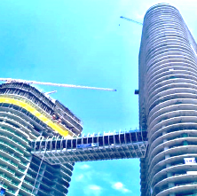
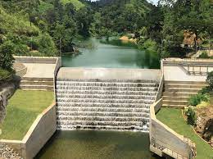
WHAT WE DO
4
01
02
03
04
05
3
BUILDING CONSTRUCTION
ROADS AND BRIDGES
WATER SUPPLY AND SANITATION
ARCHITECTURAL AND STRUCTURAL DESIGN
PROPERTY DEVELOPMENT

Slide 5
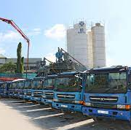
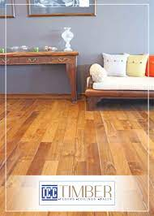
OUR PRODUCTION CAPACITY
QUARRIES AND CRUSHERS
ASPHALT AND READY-MIX
CONCRETE PLANTS
STEEL AND ALUMINUM YARDS
PRECAST CONCRETE YARDS
DURRA SOLUTIONS – WALLS AND FIRE DOORS
Timber Flooring
Unit

Slide 6
ICC PRODUCTION & SUBSIDIARIES

Slide 7
ICC TIMBER PRODUCTION FACILITY
2.
Factory Introduction

Slide 8
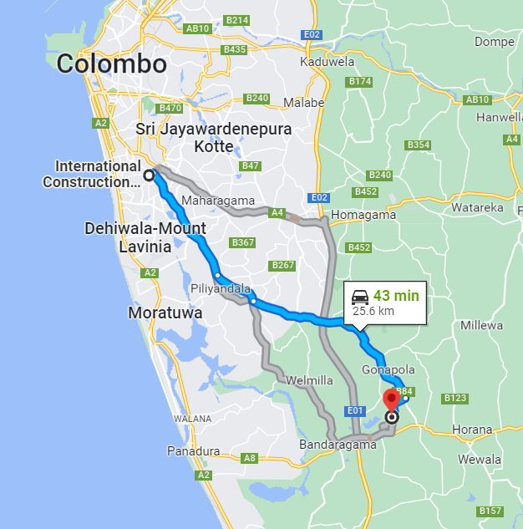
ICC TIMBER FLOORING UNIT
With over 20 years of timber carpentry work experience, ICC launched the Timber Processing Facility in 2017
The Facility is in Bandaragama, Western Province, Sri Lanka
Core business product – Pre-Finished Timber Flooring
Monthly flooring production : 10000 sq.ft
Timber species : Teak / Kumbuk / Paramara
Contributes as a timber solutions provider when necessary
Conforms the quality control procedures as per the standards

Slide 9
ICC TIMBER FLOORING UNIT
Land extent : 2 Hectares
Main Buildings : 03 Nos
Floor Area : 64000 Sq.ft
Building 01 : Primary Sawing and Treatment
Building 02 : Pre-Finished Flooring and Finishing
Building 03 : Drying and Carpentry Workshop

Slide 10
ICC TIMBER FLOORING TYPES
3.

Slide 11
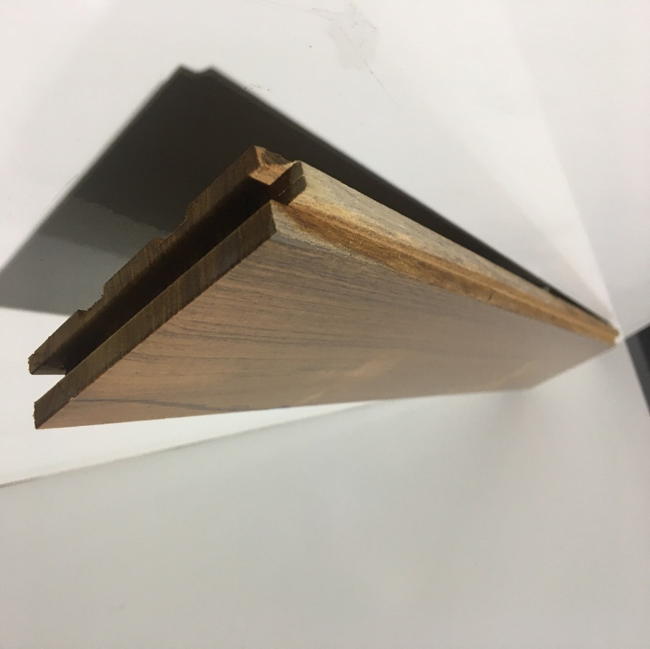
Density Kg/m³ | Strength | Modulus of Elasticity N/mm² | Modulus of Rapture N/mm²
720 | Strong | 11560 | 88
600 | Moderately Strong | 9900 | 75
650 | Strong | 10590 | 80
Teak
MATERIALS
USED
Para-Mara
Cypress
Pre-finished timber flooring which consist of several layers of paint coats on different timber species

Slide 12
ICC TIMBER FLOORING – PRODUCT INTRODUCTION
4.

Slide 13
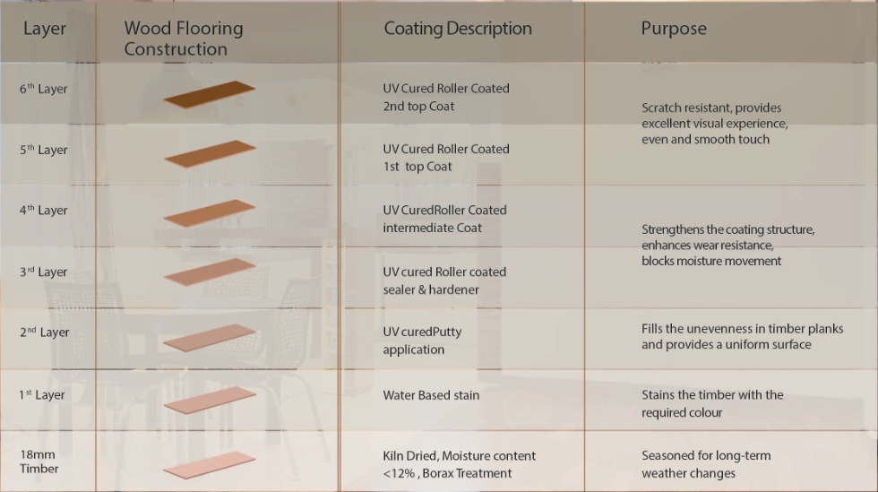
PAINT
COATING
Australia

Slide 14
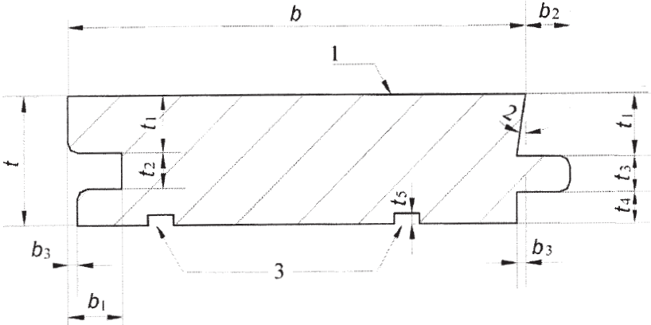
2 | Slope | 1º
3 | Glue pockets
t | Thickness | 18
t1 | Thickness above groove | 7
t2 | Width of groove | 6.4
t3 | Thickness of tongue | 6
t4 | Thickness below tongue | 5
b | Width | 100/50/130
b1 | Depth of groove | 7
b2 | Width of tongue | 5
b3 | undercut | -
TONGUE
AND
GROOVE
Groove
Tongue
BS EN 8201 : 2011

Slide 15
DIMENSIONS
Species | Dimensions
 | Length | x | Width | x | Thickness
 | (mm) |  | (mm) |  | (mm)
Teak | 600 x 100 x 18
 | 900 x 100 x 18
 | 600 x 50 x 18
Para-Mara | 900 x 100 x 18
Cypress | 1000 x 130 x 18
Length
Width
Thickness

Slide 16
PRODUCTION LINE
Timber Seasoning and Treatment
Incoming Timber Logs
Sawing the Timber
Pressure Impregnation
Kiln Drying
PRODUCTION LINE
Timber Plank Preparation
Ripping
Planning
Four Side Moulder
End Matching
PRODUCTION LINE
Paint and Finishing Line
Water Based Staining
Stain Application
Sealer Application
Top coat

Slide 17
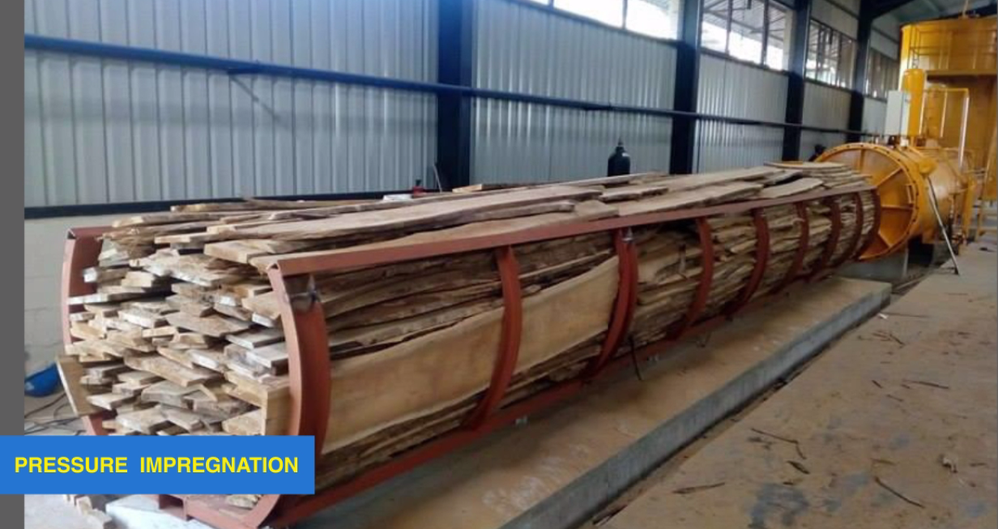
PRESSURE IMPREGNATION
Boron Borax treatment
Boron Borax mixture
Environment Friendly
Non toxic
Addresses the issue with related to
Termites,
Infestation of insects
Fungai

Slide 18
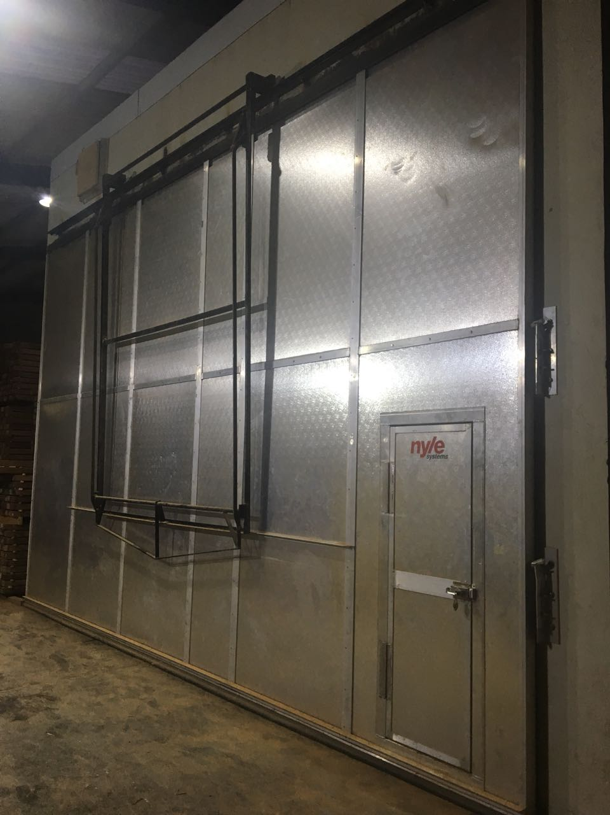
NYLE DEHUMIDIFICATION KILN DRYING SYSTEM
Step by Step Drying Process
Different Approach for each timber
Patented system
Precise Conditioning
Computerised system
Pioneer in kiln driers

Slide 19
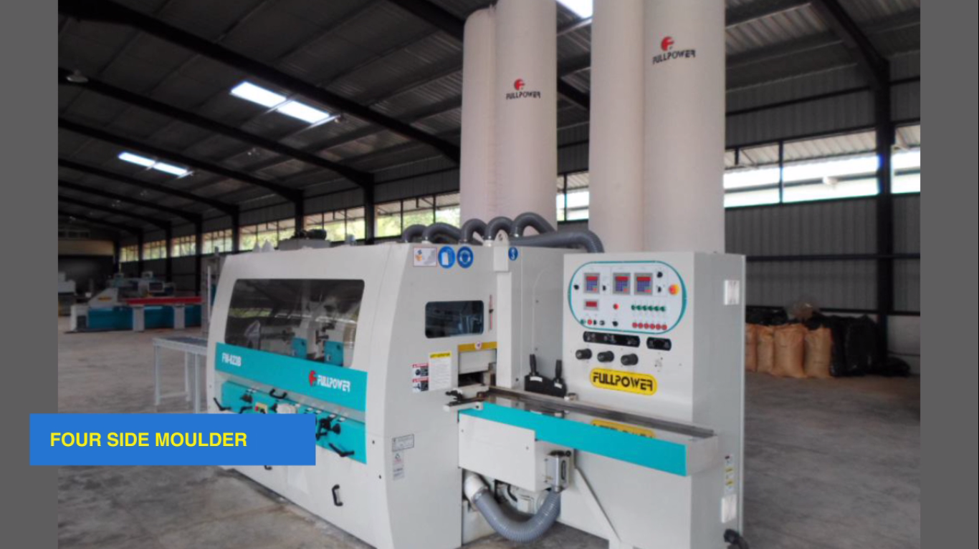
TIMBER PLANK PREPARATION
Four-Side Moulding and End matching
Moulding
Tongue and groove
Tongue – 6mm
Groove – 6.4mm
Glue Pocket
Cross Cutting
End Matching
Tongue – 6mm
Groove – 6.4mm

Slide 20
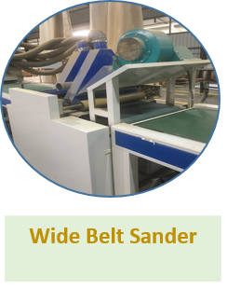
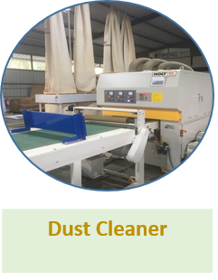
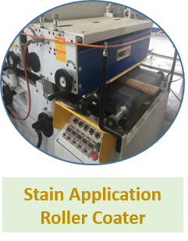
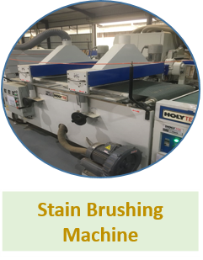
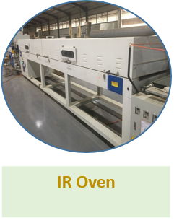
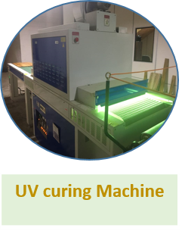
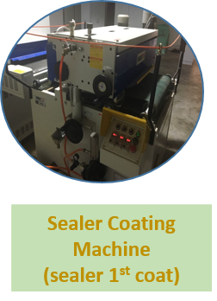
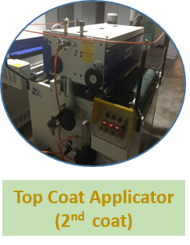
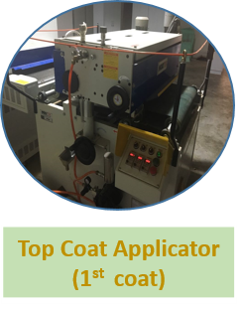
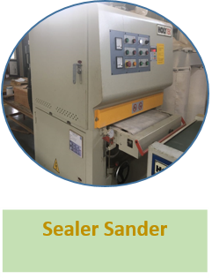
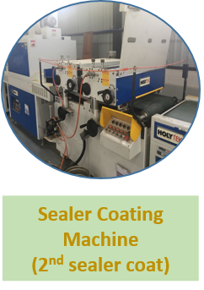
PAINT FINISHING LINE

Slide 21
10 STAGES OF QUALITY ASSURANCE
BEHAVIOUR DURING SERVICE LIFE
DEFECTS IN LOGS
QUALITY OF PAINTS
Quality Assurance Points
Production Process
Service life Performance
Incoming Material
Incoming Material
QA 1
QA 2
QA 3
QA 4
QA 5
QA 6,7,8
QA 9
QA 10
Primary Sawing
Pressure Impregnation
Delivery
Production
Kiln Drying
Ripping & Planning
CONSIGNMENT
Finishing Line
ACCURATE DIMENSIONS
TESTS DURING TREATMENT
Tongue & Grooving
Sanding
PERFECT FINISH
STANDARD COLOUR
CORRECT COATING
UV coating line

Slide 22
INTERNATIONAL TESTED PARAMETERS
C
D
MOISTURE TESTS
DEPTH OF PENETRATION OF PRESERVATIVES
ABRASION RESISTANCE AS 1580.408.2.2006
SCRATCH RESISTANCE – DOUBLE RUB TEST & STEEL WOOL RUB TEST ASTM D7835
ADHESION – CROSS HATCH ADHESION TEST Minimum pass classification AS 1580.408.4-2004
COATING COVERAGE
A&I SPECIFICATION 13386
MEASUREMENT OF GLOSS & MATT LEVELS
QUALITATIVE CHECKS FOR SERVICE
F
E
B
A
H

Slide 23
FLOORING INSTALLATION TECHNIQUE
5.

Slide 24
UNIQUE INSTALLATION SYSTEM
50% to 70% faster
Can be installed on any flat, clean stable surface
Cushion feeling
Superior comfort
Reduced impact noise
Only tools - utility knife
No messy glues
Serviceable as installed
Free of volatile materials
Odor free
Long shelf life
Worldwide Patent

Slide 25
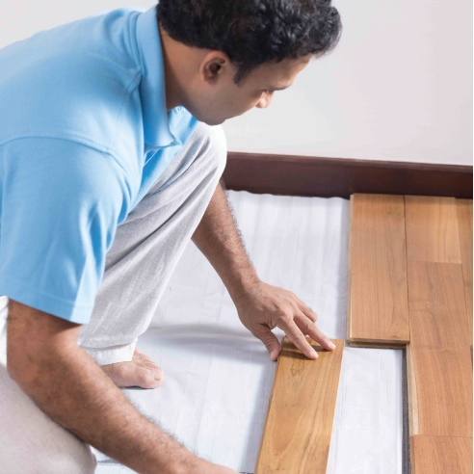
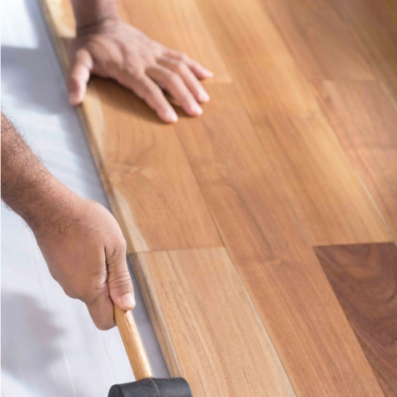
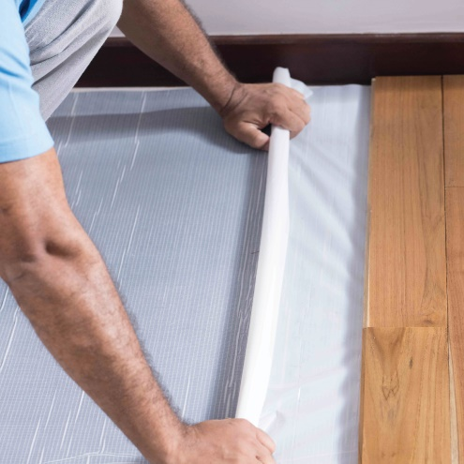
STEP - 01
STEP - 02
DO IT YOURSELF
ANYONE CAN INSTALL
STEP 1 : CLEAR THE FLOOR & MEASURE LEVELS
STEP 2 : LAYING THE ELASTILON LAYER
STEP 3 : LAY THE TIMBER PLANKS
STEP 4 : REMOVING THE ELASTILON LAYER
STEP - 03
STEP - 04
25
International Construction Consortium (Pvt) Ltd

Slide 26
WHY ARE WE SPECIAL?
6.

Slide 27
FASTEST
TIMBER FLOORING SOLUTION IN
SRI LANKA
International Construction Consortium (Pvt) Ltd

Slide 28
100%
NATURAL
&
MANUFACTURED
IN SRI LANKA
International Construction Consortium (Pvt) Ltd

Slide 29
NOT
JUST A
FLOORING
SOLUTION
International Construction Consortium (Pvt) Ltd

Slide 30
A LOT OF EFFORT
BY OUR
SPECIALIZED
TEAMS
International Construction Consortium (Pvt) Ltd

Slide 31
TO DELIVER A
HIGH QUALITY
LUXURIOUS
International Construction Consortium (Pvt) Ltd

Slide 32
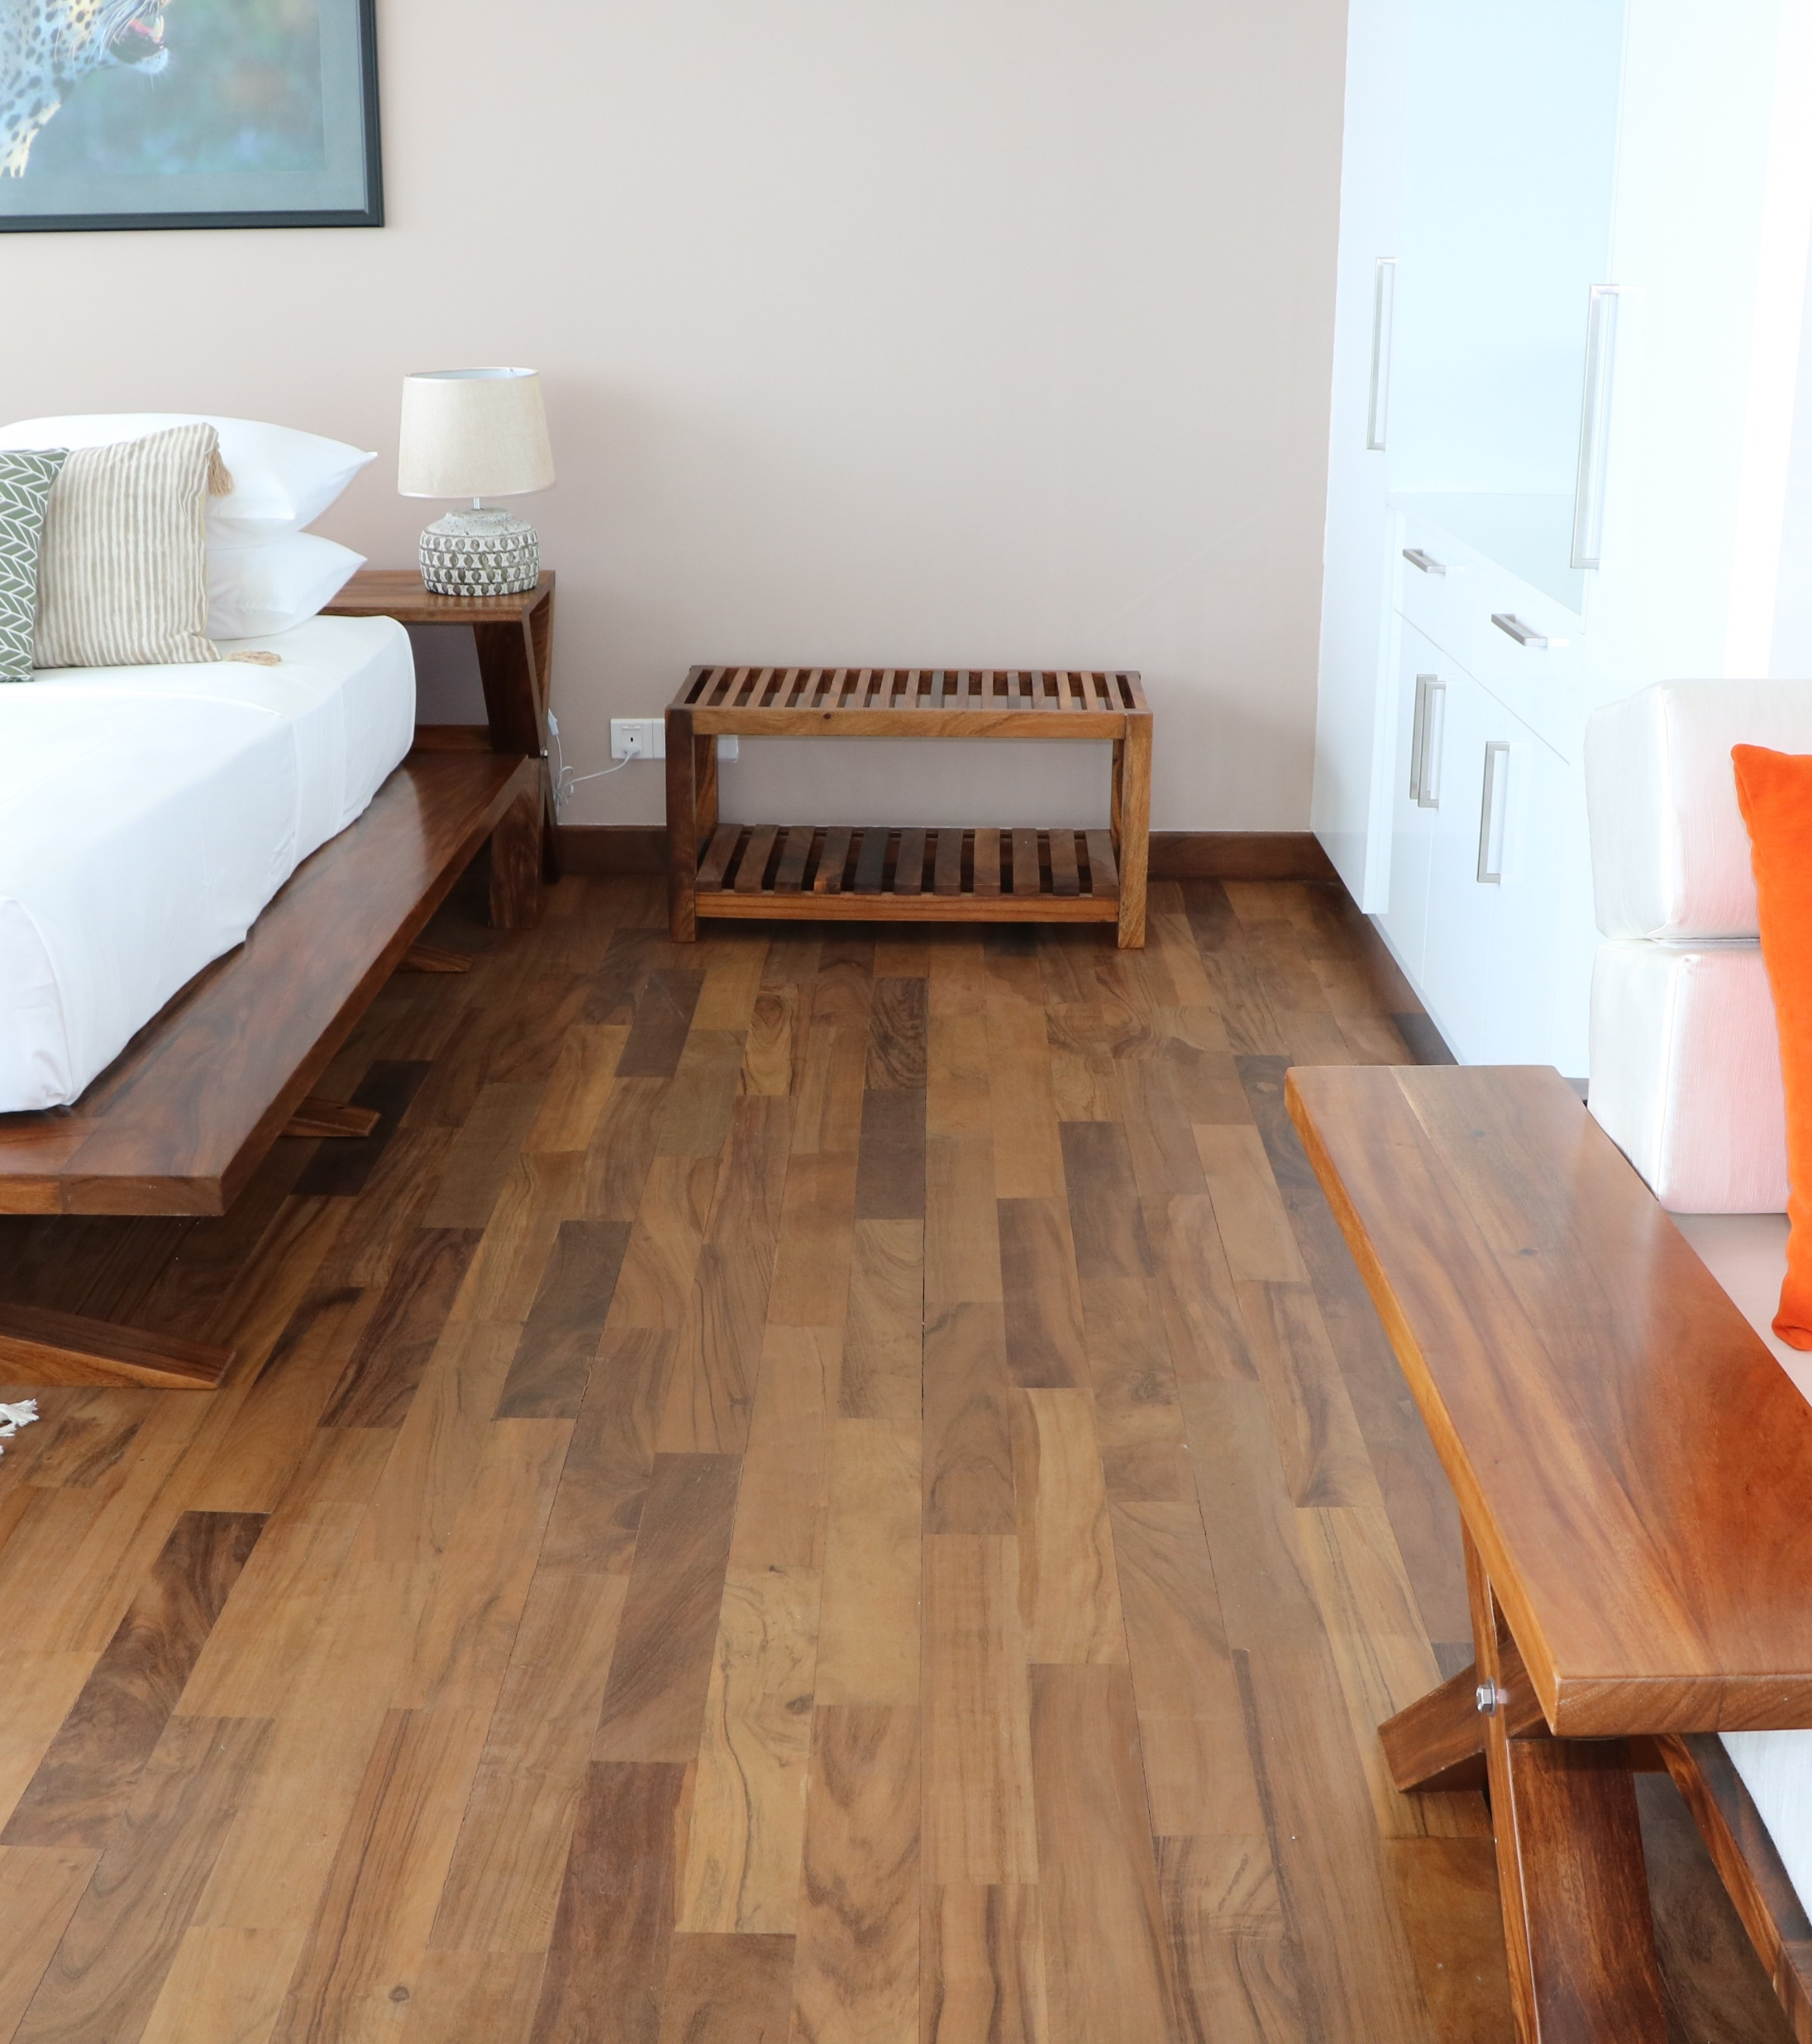
Can Lay
On any Surface
WAIT!
IT GETS EVEN BETTER
5X
Faster than conventional method.
No
Battens / Painting / Sandering/ Dust on site
Convenient
Installation
Prefinished
Made to measure

Slide 33
Hardwood floors are always an asset when you sell
-The San Diego Union Tribune

Slide 34
INTRODUCING
AS AN
ALTERNATIVE
FOR
TILES

Slide 35
OTHER TIMBER PRODUCTS
7.

Slide 36
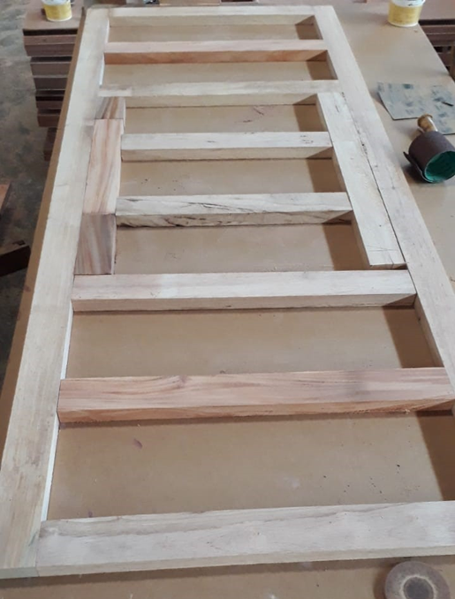
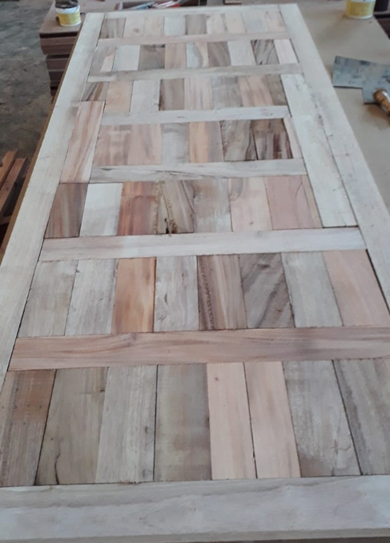
TIMBER ENGINEERED DOOR

Slide 37
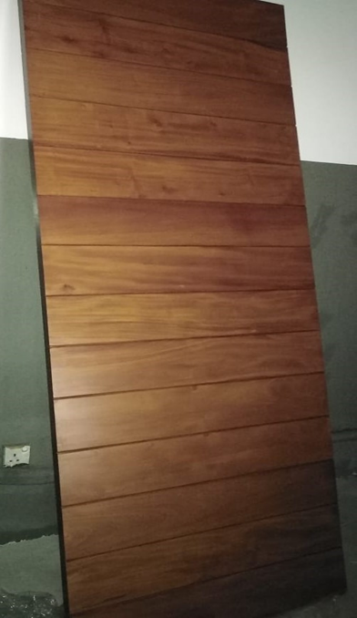
TIMBER ENGINEERED DOOR
Engineered Door
Item | Element | Material Used
Door Sash | Sub Frame | Treated Rubber
 | Core Material | Treated Solid Timber Parts
 | Face Timber | 8mm tk. Mahogany/ Teak Veneer
Door Frame | Frame | Treated Mahogany / Teak
 | Architraves | Treated Mahogany / Teak

Slide 38
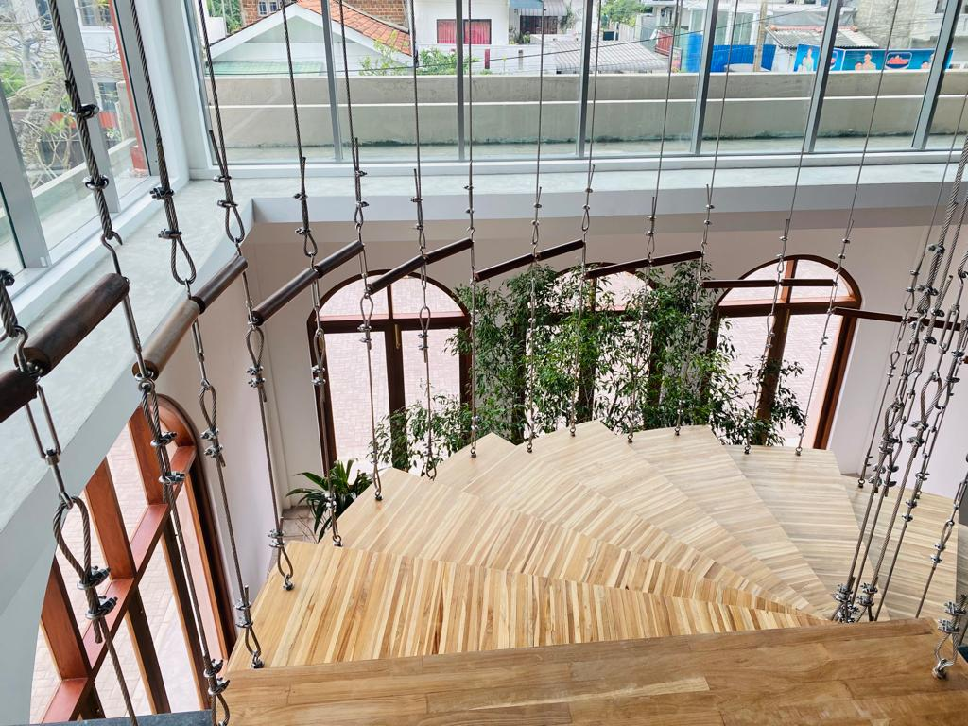
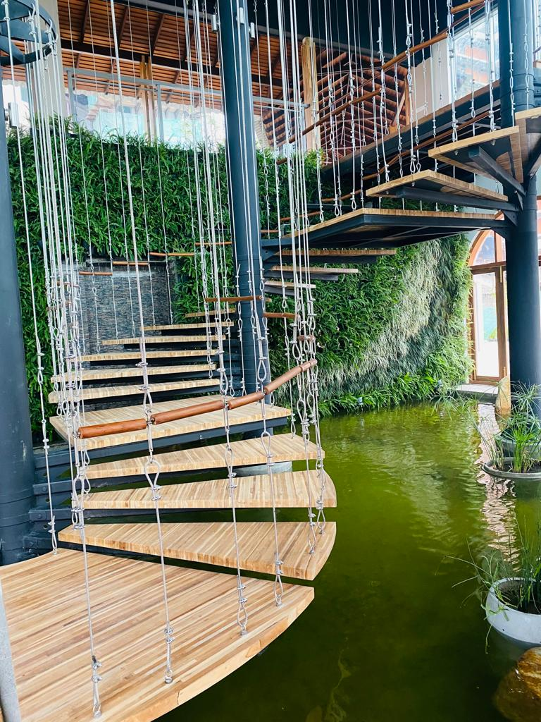
TIMBER STAIRCASES

Slide 39
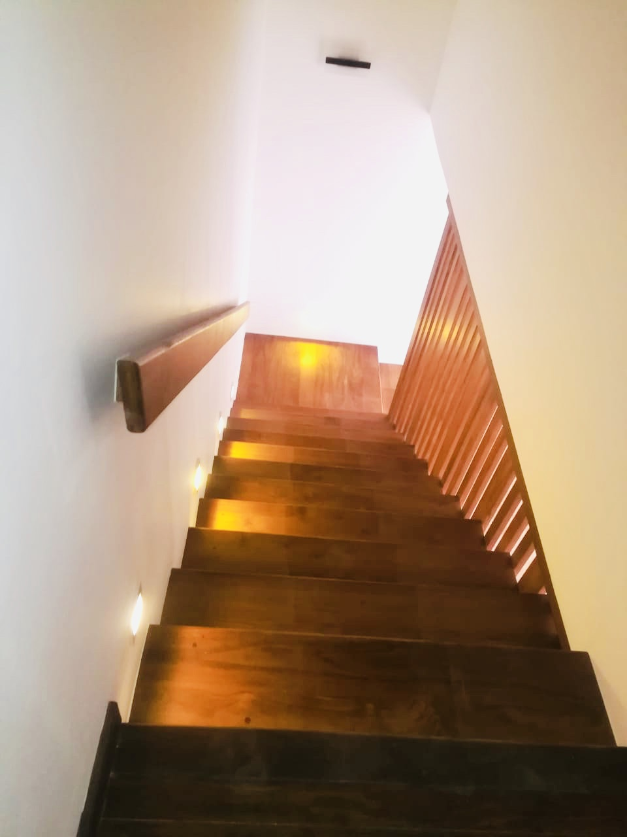
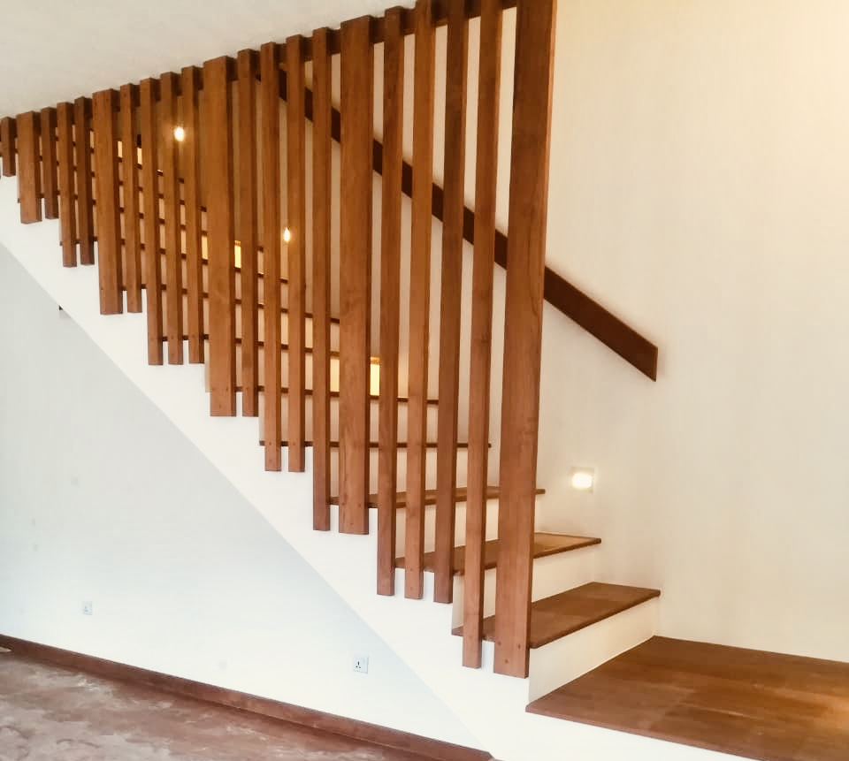
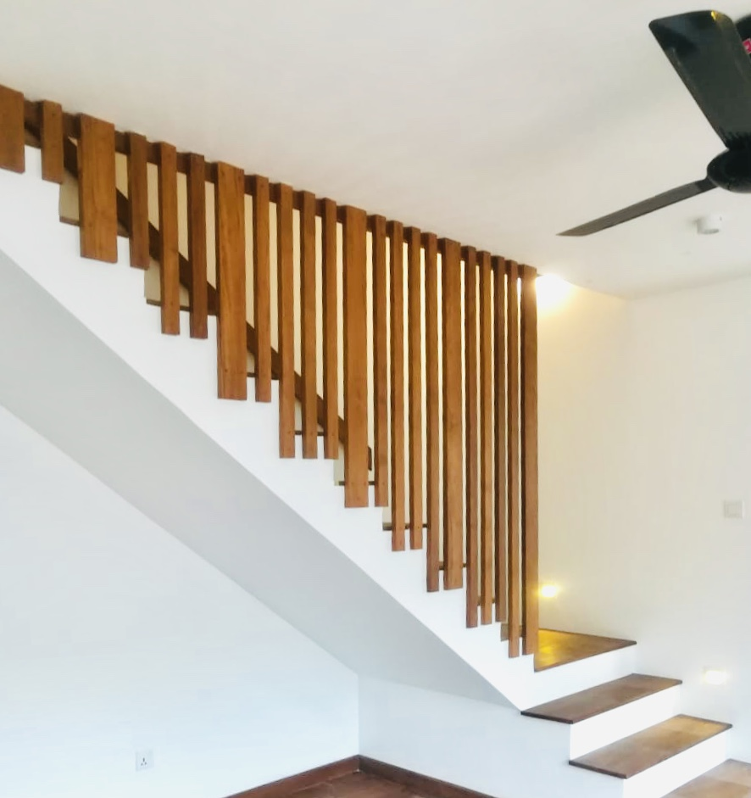
TIMBER STAIRCASES

Slide 40
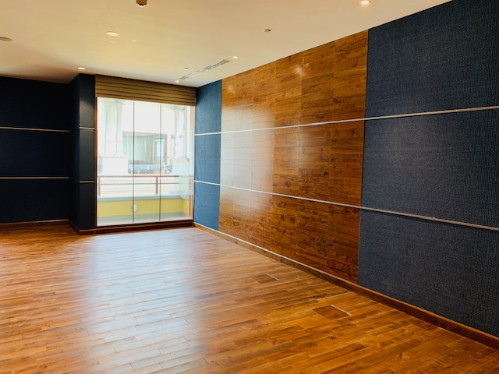
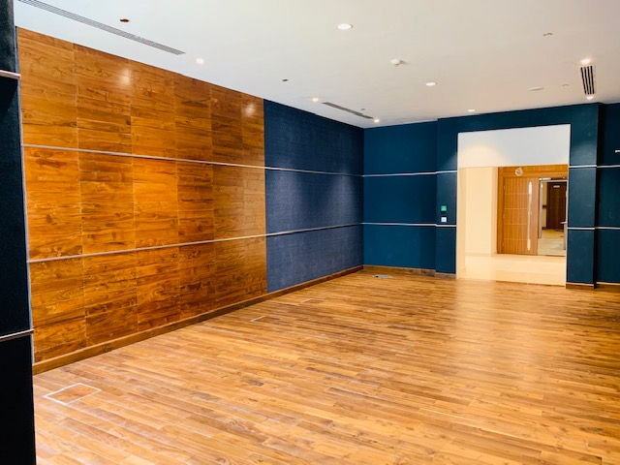
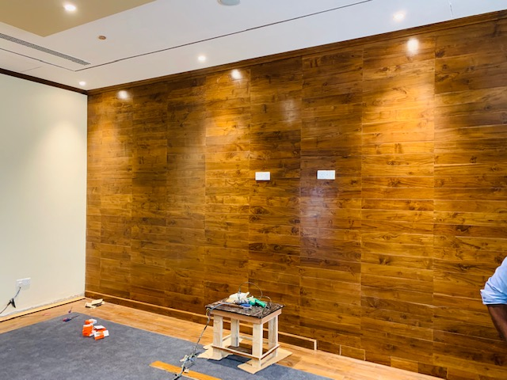
TIMBER WALL CLADDING

Slide 41
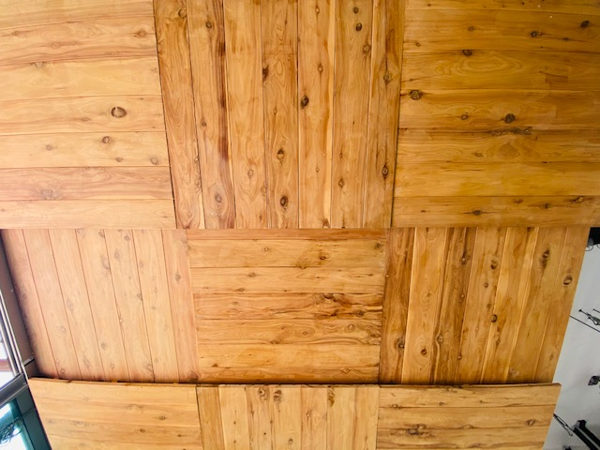
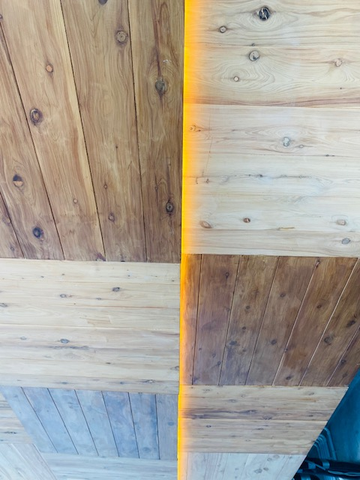
TIMBER CEILING

Slide 42
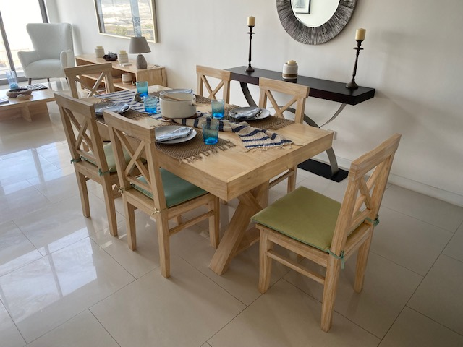
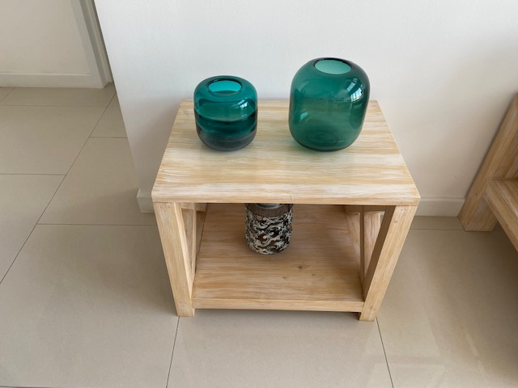
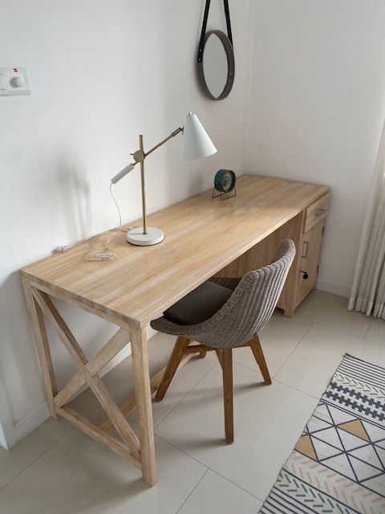
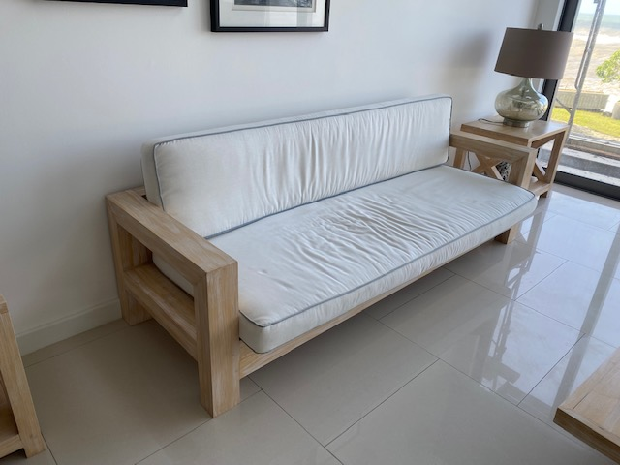
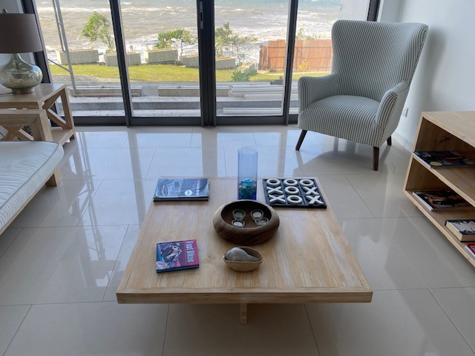
TIMBER FURNITURE

Slide 43
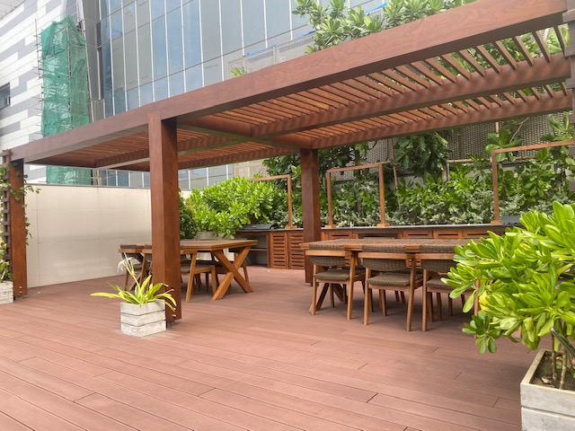
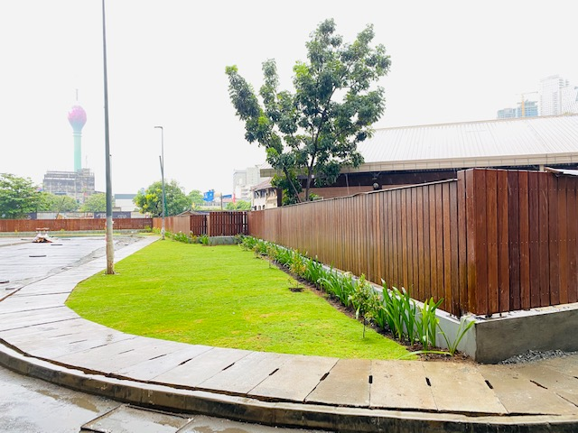
TIMBER PERGOLA
TIMBER FENCE

Slide 44
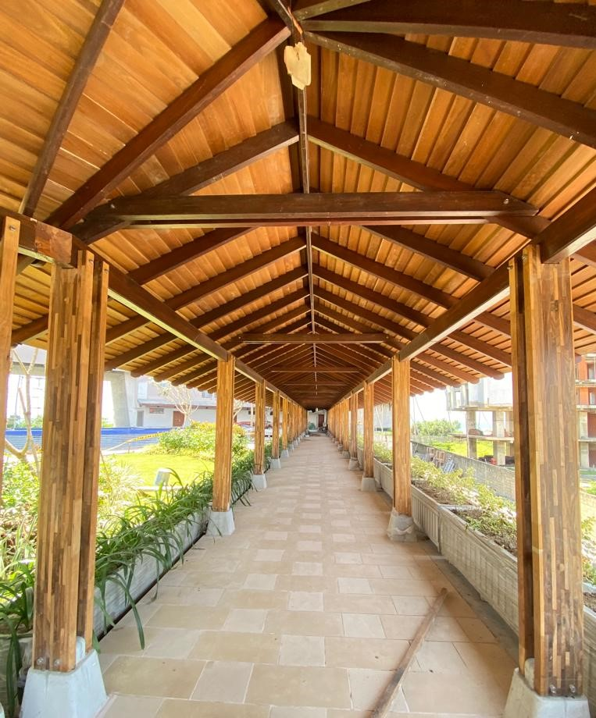
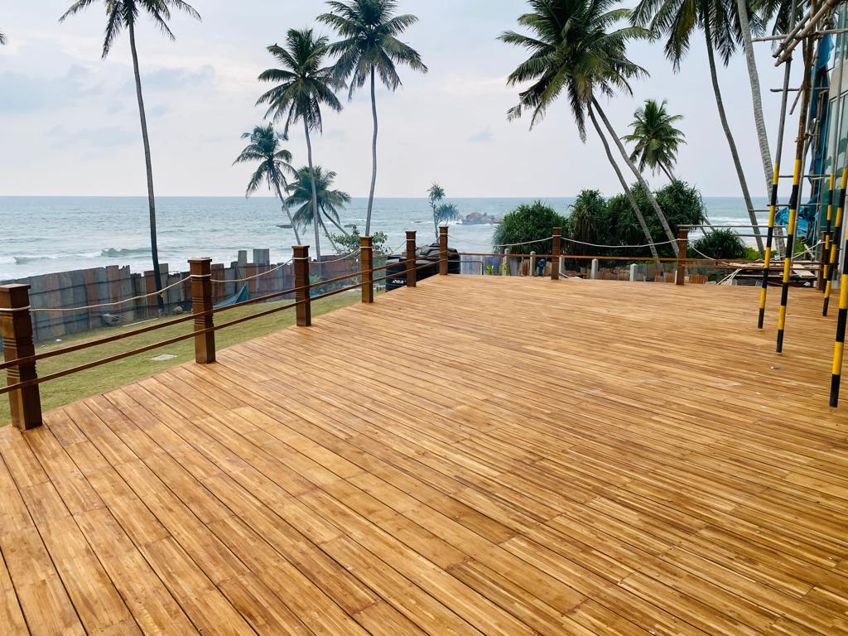
BYPRODUCTS FROM WASTE MATERIAL

Slide 45
REACH ICC-
”THE TOTAL
SOLUTION PROVIDER
FOR TIMBER”

Slide 46
THANK YOU !

